Slide 1
Large-scale functional annotation
Kris Gunsalus
XDAS Fall 2019

Slide 2
Pathway and network analysis
Approaches to analyze functional enrichment
Network visualization
Network inference

Slide 3
How do we define ”function”?
KEGG: Kyoto Encyclopedia of Genes and Genomes
Reactome: expert-curated pathways
GO: Gene Ontology
Directed acyclic graph
Three ontologies:
Biological Process (BP)
Cellular Component (CC)
Molecular Function (MF)
Multiple sources of annotation
Biochemistry, genetics, electronically inferred (e.g. from homologs)

Slide 4
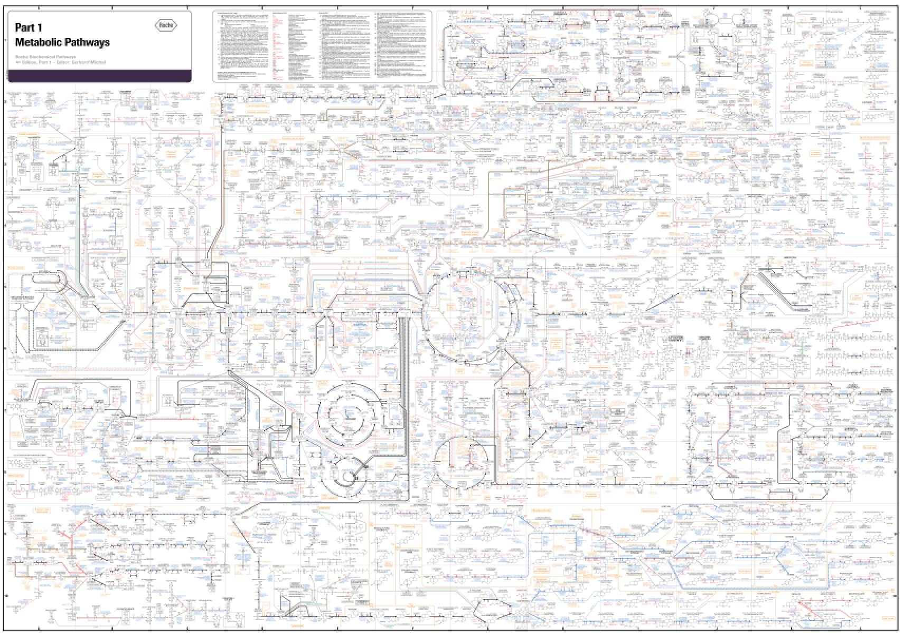
Biochemical-pathways.com

Slide 5
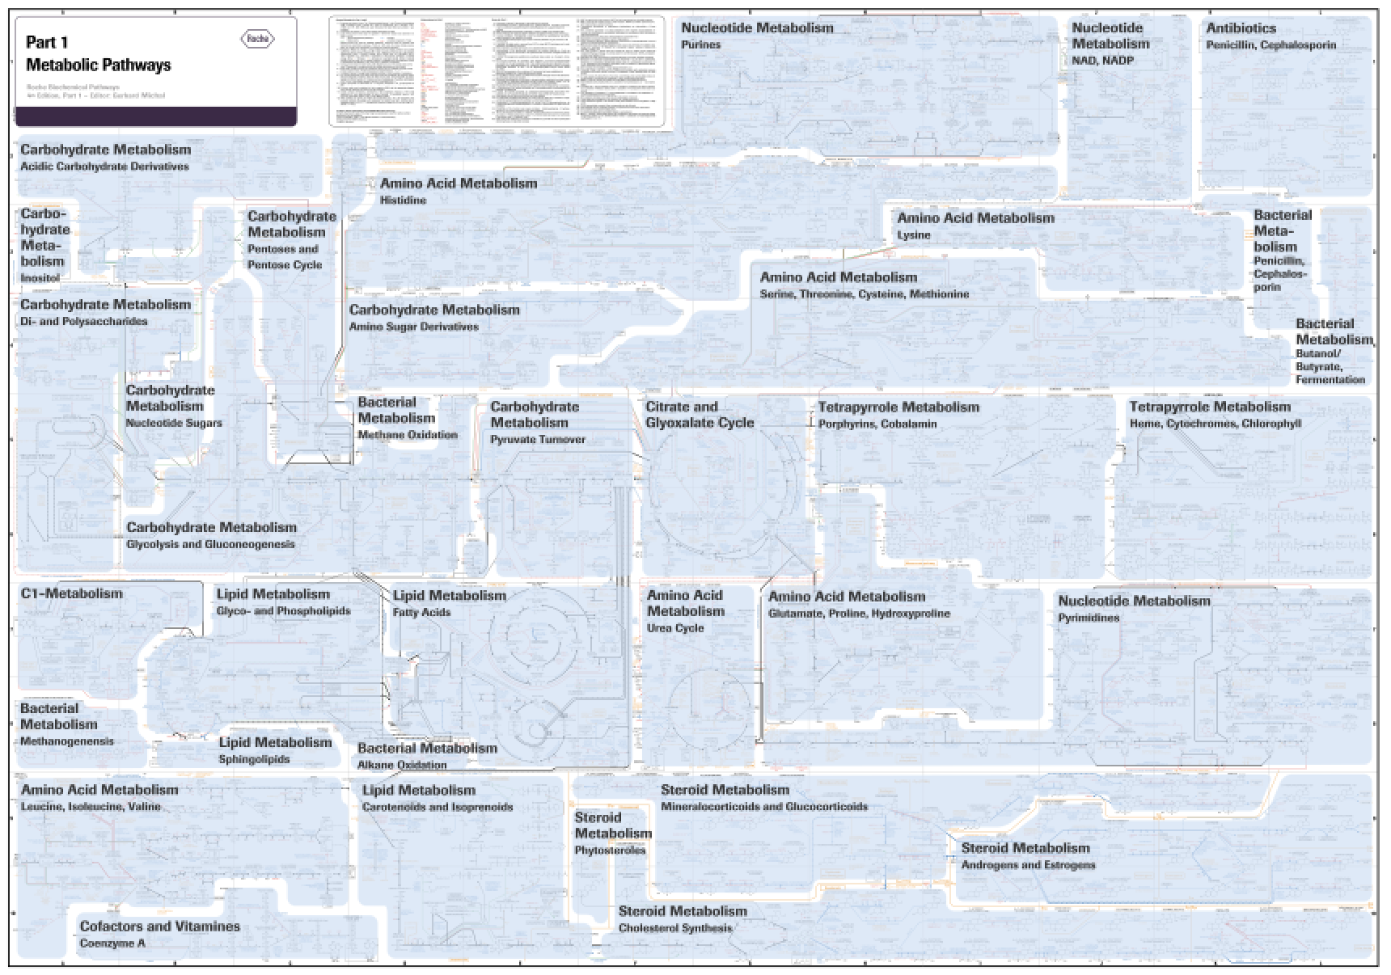
Biochemical-pathways.com

Slide 6
Biochemical-pathways.com

Slide 8
Gene Ontology: example

Slide 9
Gene Ontology: example

Slide 10
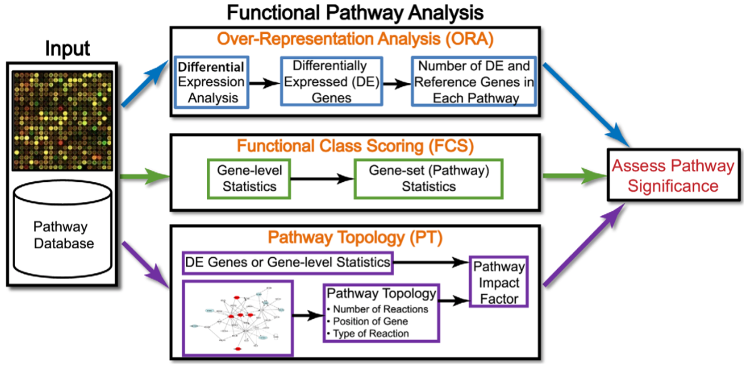
Three generations of pathway analysis
Large-scale studies often produce lists of genes that are perturbed in some way
Pathway analysis reduces complexity and increases explanatory power
Khatri et al. (2012) PLoS Comp Biol 8:e1002375

Slide 11
Over-representation Analysis (ORA)
Approach
Input list
up-or down-regulated genes, RNAi hits, etc.
Assess proportion of genes with a particular annotation
GO term, pathway membership
Compare against universe of all possible genes
Assess over- or under-representation
"2x2" method: Tabular Statistics
hypergeometric, chi-squared, binomial distributions
Limitations
Statistical tests independent of measured changes
Uses only most significant genes
Assumes genes (and annotations) are independent of each other
Notes:
e.g. 2-fold, p-value <0.05, FDR 5%

Slide 12
Functional Class Scoring (FCS)
Approach
Try to capture weaker coordinated changes that can cumulatively be informative
Compute gene-level statistics: significance of deviation from background distribution
t-test, Z-score, Q-statistic, ANOVA, signal-to-noise, correlation with phenotype
Aggregate gene-level statistics into a single pathway-level statistic
Univariate or multivariate (account for dependencies b/w genes)
E.g. KS test, Wilcoxon rank sum (Mann-Whitney), ANCOVA
Assess pathway-level significance
Competitive null hypothesis (permute pathway labels)
vs. self-contained null hypothesis (permute class labels)

Slide 13
Functional Class Scoring (FCS)
Advantages
Do not require arbitrary threshold for significance of groups
Use all available molecular measurements for pathway analysis
Detect coordinated changes in pathway components
Account for dependence between genes in pathway
Limitations
Analyzes each pathway independently
May use changes to rank genes in a pathway only
(Exception: some methods use sum or mean of gene-level scores to compute pathway-level score)

Slide 14
GSEA: Gene Set Enrichment Analysis
Subramanian et al., PNAS 2005
Notes:
Figure 1 A GSEA overview illustrating the method. (A) An expression data set sorted by correlation with phenotype, the corresponding heat map, and the “gene tags,” i.e., location of genes from a set S within the sorted list. (B) Plot of the running sum for S in the data set, including the location of the maximum enrichment score (ES) and the leading-edge subset.

Slide 15
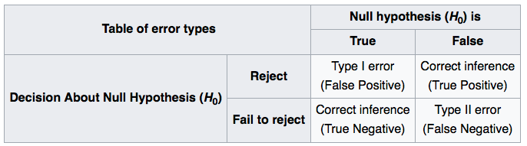
Controlling errors

Slide 16
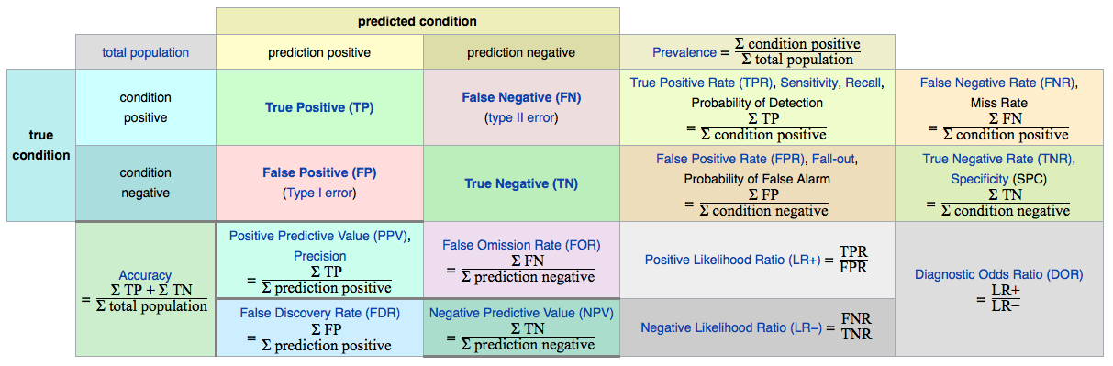
Controlling errors
Precision-recall (AUC)
Sensitivity-specificity
Log odds ratio

Slide 17
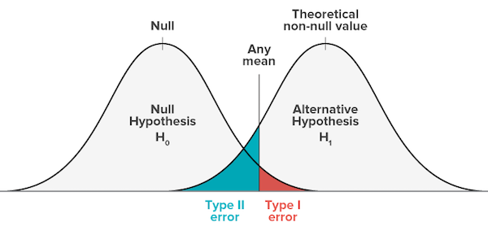
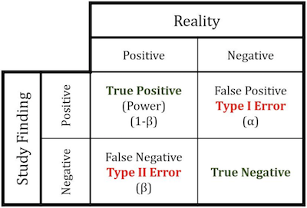
Effect size, error rates, power

Slide 18
GSEA: Gene Set Enrichment Analysis
Step 1: Compute enrichment score (ES)
The degree to which a set S is overrepresented at the extremes (top or bottom) of the entire ranked list L
Procedure: Walk down L, increase (decrease) running-sum statistic if gene is (not) in S
The magnitude of the increment depends on the correlation of the gene with the phenotype
ES = maximum deviation from 0
Step 2: Estimate significance of ES (P value)
Permutation test: generate null distribution by permuting class (phenotype) labels
Permuting class labels preserves gene-gene correlation structure
Empirical P-value is observed ES relative to null distribution
Step 3: Calculate false discovery rate (FDR)
Normalize ES for each gene set to account for size of set (NES)
Compare tails of observed and null distributions
Subramanian et al., PNAS 2005
Notes:
There are three key elements of the GSEA method:
Step 1: Calculation of an Enrichment Score. We calculate an enrichment score (ES) that reflects the degree to which a set S is overrepresented at the extremes (top or bottom) of the entire ranked list L. The score is calculated by walking down the list L, increasing a running-sum statistic when we encounter a gene in S and decreasing it when we encounter genes not in S. The magnitude of the increment depends on the correlation of the gene with the phenotype. The enrichment score is the maximum deviation from zero encountered in the random walk; it corresponds to a weighted Kolmogorov–Smirnov-like statistic (ref. 7 and Fig. 1B).
Step 2: Estimation of Significance Level of ES. We estimate the statistical significance (nominal P value) of the ES by using an empirical phenotype-based permutation test procedure that preserves the complex correlation structure of the gene expression data. Specifically, we permute the phenotype labels and recompute the ES of the gene set for the permuted data, which generates a null distribution for the ES. The empirical, nominal P value of the observed ES is then calculated relative to this null distribution. Importantly, the permutation of class labels preserves gene-gene correlations and, thus, provides a more biologically reasonable assessment of significance than would be obtained by permuting genes.
Step 3: Adjustment for Multiple Hypothesis Testing. When an entire database of gene sets is evaluated, we adjust the estimated significance level to account for multiple hypothesis testing. We first normalize the ES for each gene set to account for the size of the set, yielding a normalized enrichment score (NES). We then control the proportion of false positives by calculating the false discovery rate (FDR) ( 8, 9) corresponding to each NES. The FDR is the estimated probability that a set with a given NES represents a false positive finding; it is computed by comparing the tails of the observed and null distributions for the NES.

Slide 19
FWER vs FDR
Null hypothesis testing methods adjusted for multiple comparisons (multiple hypothesis testing)
Family-wise error rate (e.g. Bonferroni correction):
Control the probability of at least one Type I error
Most conservative
False Discovery rate (Benjamini Hochberg):
Control the expected proportion of rejected null hypotheses that are false (incorrect rejections)
Less conservative, more Type I errors
Greater power (probability that the test correctly rejects the null hypothesis when the alternative hypothesis is true)

Slide 20
Pathway Topology (PT)
Approach
Use annotation databases that catalog interactions
Activation, inhibition, physical, metabolic
Cellular compartment
Same steps as FCS (functional class scoring), BUT use pathway topology to compute gene-level statistics
Similarity between genes based on proximity in network (metabolic networks)
E.g. correlation, covariance weighted by graph distance
IF: impact factor (signaling pathways)
Model signaling pathways as graphs (nodes, edges)
Gene-level statistic is PF: perturbation factor
Expression AND linear function of PF for all genes in pathway
IF is sum of all PFs for pathway

Slide 21
Pathway Topology (PT)
Limitations
Networks are not necessarily the same in each cell
Condition-specific changes not known or annotated
Do not model dynamic states
Do not model interdependence between pathways
All methods will improve as resolution, accuracy, and completeness of annotations increase

Slide 22
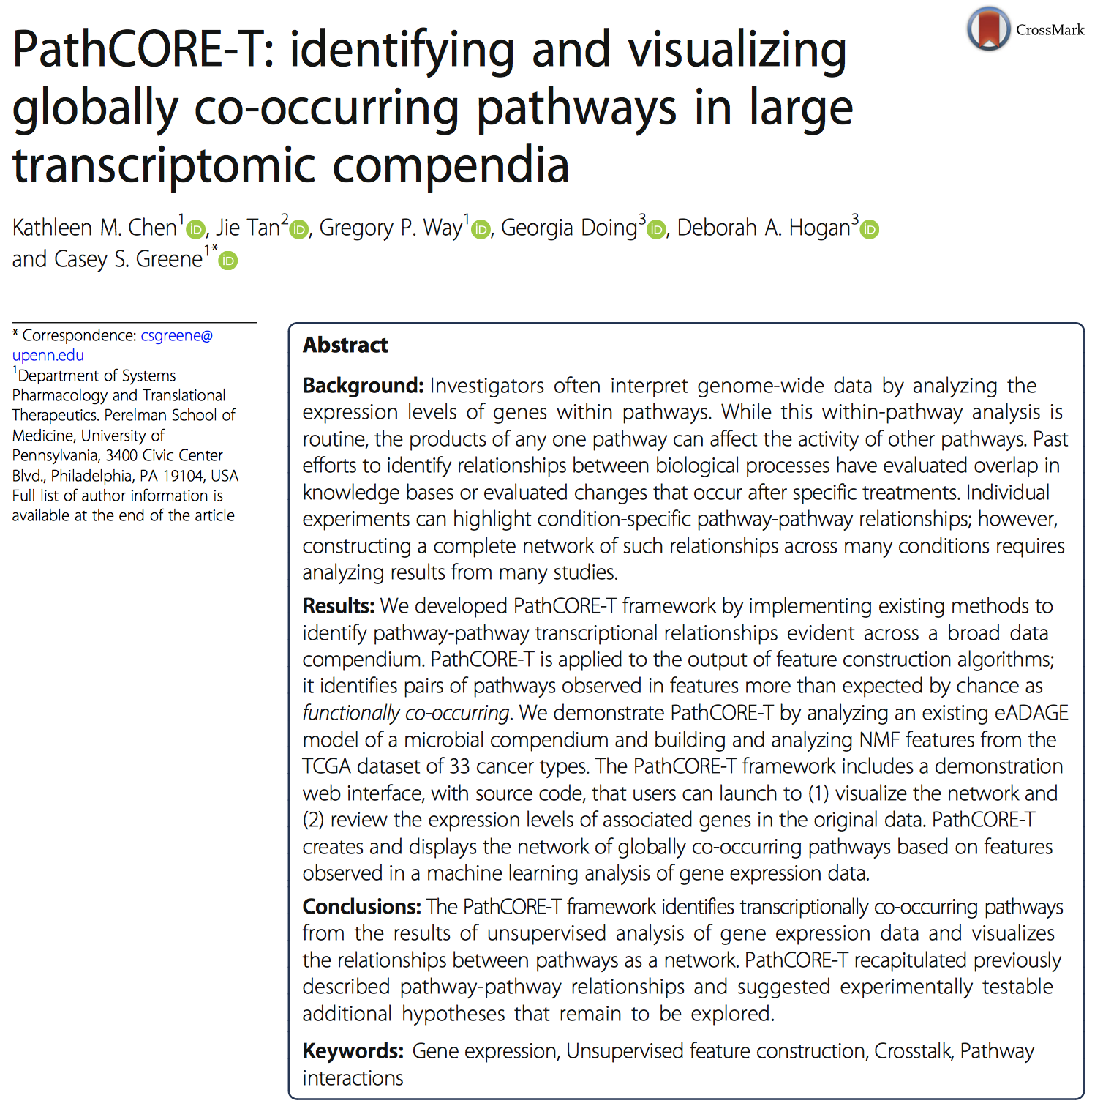
PathCORE-T
Chen et al. BioData Mining (2018) 11:14 | https://doi.org/10.1186/s13040-018-0175-7

Slide 23
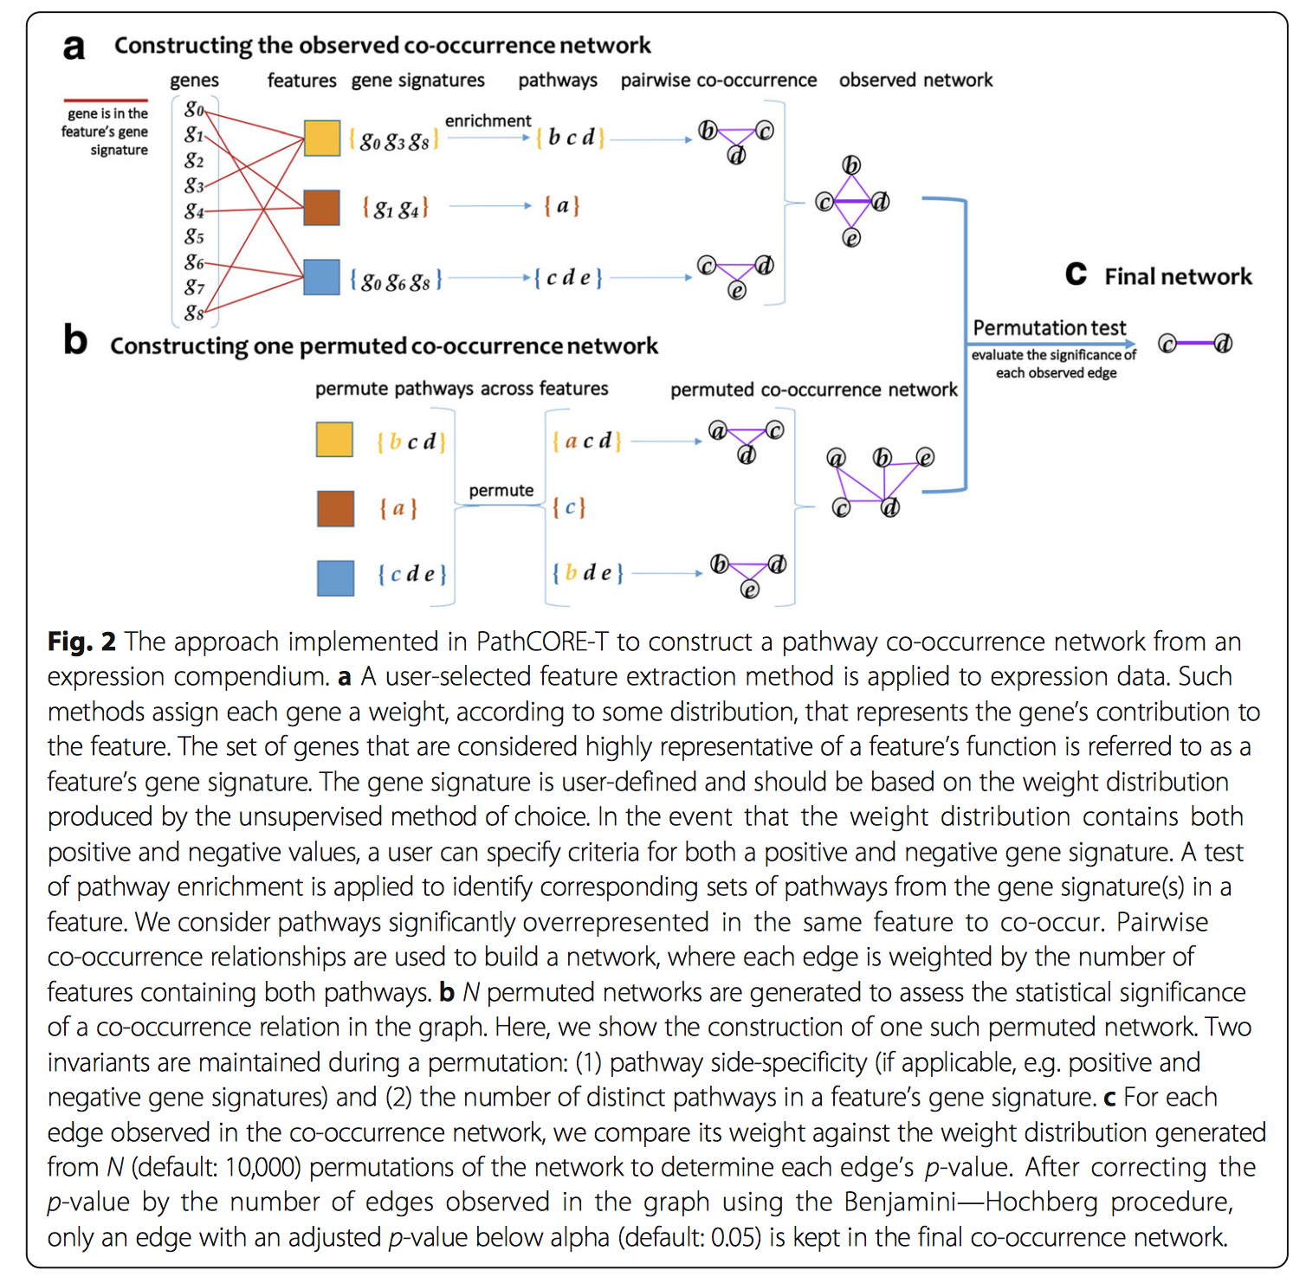
PathCORE-T
Chen et al. BioData Mining (2018) 11:14 | https://doi.org/10.1186/s13040-018-0175-7

Slide 24
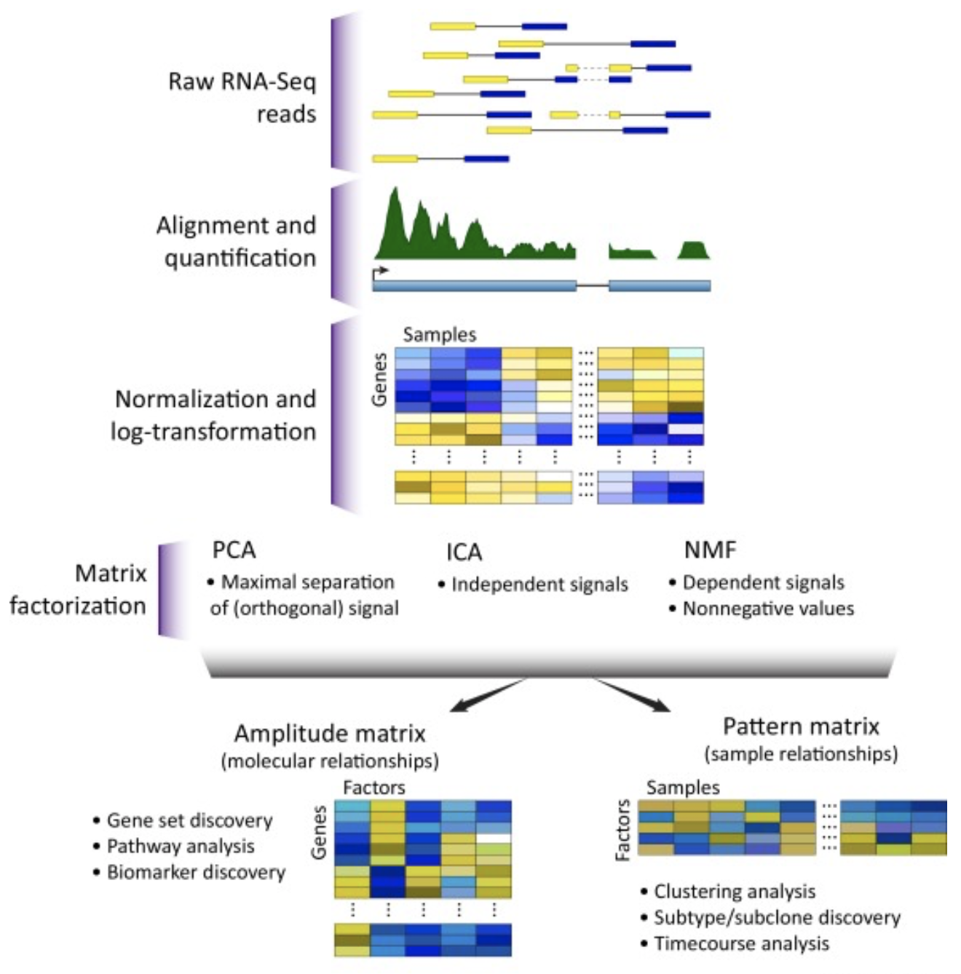
Enrichment analysis: feature extraction by matrix factorization
Stein-O’Brien et al., Trends Genet 2018
https://doi.org/10.1016/j.tig.2018.07.003

Slide 25
Enrichment analysis: feature extraction by matrix factorization
Stein-O’Brien et al., Trends Genet 2018
https://doi.org/10.1016/j.tig.2018.07.003

Slide 26
Dcell: Visual neural network
for prediction of phenotypes and GIs
Ma et al, Nature 2018 (Ideker lab)
Notes:
Figure 1 | Modeling system structure and function with visible learning. (a) A conventional neural network translates input to output as a black box without knowledge of system structure. (b) In a visible neural network, input–output translation is based on prior knowledge. In DCell, gene-disruption genotypes (top) are translated to cell-growth predictions (bottom) through a hierarchy of cell subsystems (middle). (c) A neural network is embedded in the prior structure using multiple neurons per subsystem. (d) Screen capture of DCell online service.

Slide 27
A really nice introduction to neural networks in 4 short videos

Slide 28
Enrichment Analysis: Seurat
Now use UMAP
Stuart, Butler et al. Cell 2019

Slide 29
Enrichment Analysis: Seurat
Stuart, Butler et al. Cell 2019

Slide 30
Enrichment Analysis: Seurat
Stuart, Butler et al. Cell 2019

Slide 31
Enrichment Analysis: Pseudotime
Trapnell et al. Nat Biotech 2014
http://bioconductor.jp/packages/3.2/bioc/vignettes/monocle/inst/doc/monocle-vignette.pdf

Slide 32
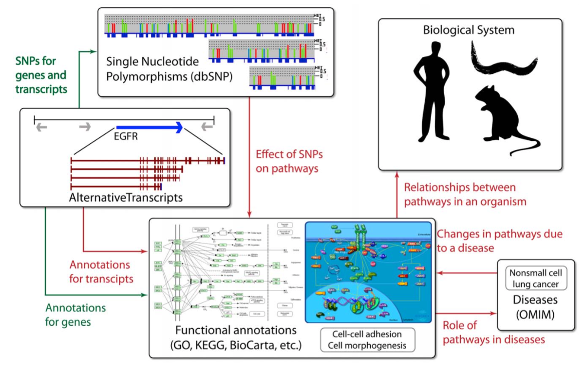
Outstanding challenges
Khatri et al. (2012) PLoS Comp Biol 8:e1002375

Slide 33
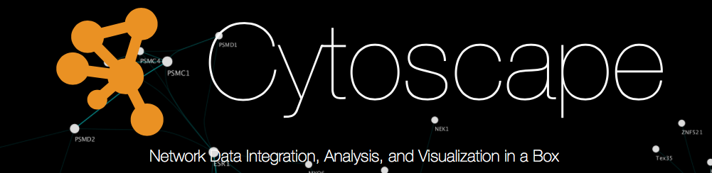
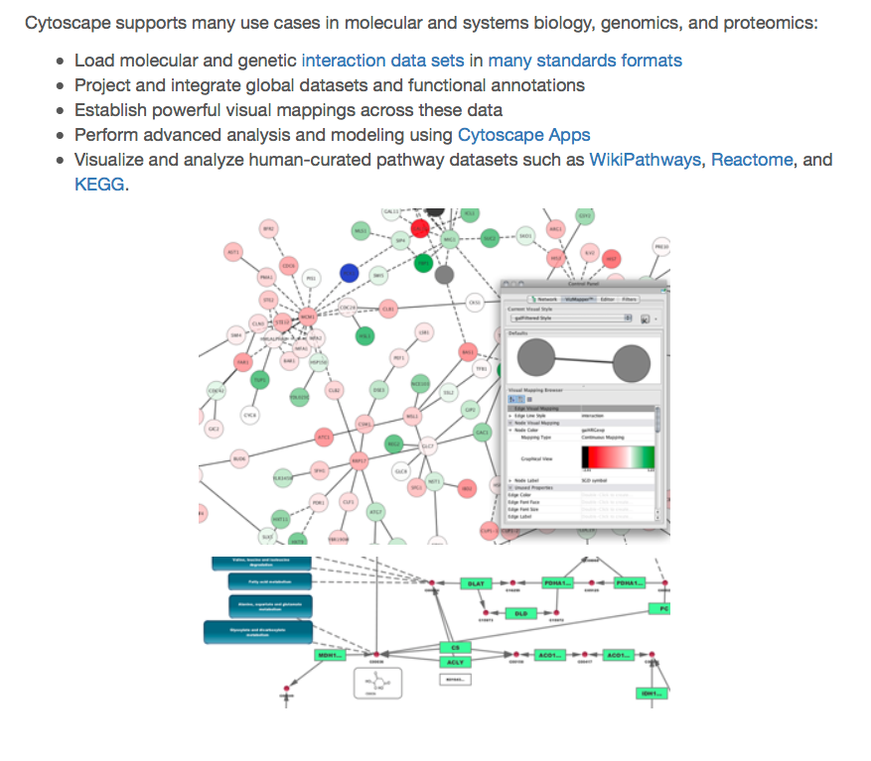

Slide 34
STRING database

Slide 36
Gene regulatory network (GRN) inference
Integrate many types of molecular and perturbation studies to generate predictive models
Gene expression, physical interactions, chromatin accessibility, histone marks, TF-gene interactions…
Combine network priors and measured features from many large-scale datasets
Mathematical models (large linear systems)

Slide 37
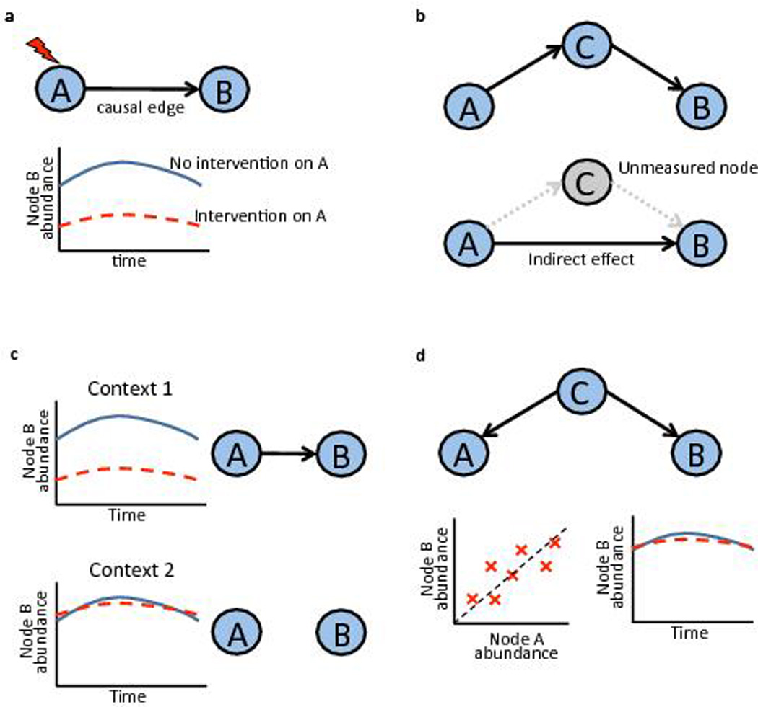
DREAM challenge: inferring causal networks
Direct, causal
(A influences B)
Indirect, causal
(A influences B)
Indirect, correlated but not causal
(A does NOT influence B)
Context-dependent interaction
Nat Methods (2016) 13:310-8. doi: 10.1038/nmeth.3773
Notes:
Causal networks. The network inference sub-challenge focused on causal relationships between nodes. (a) A directed edge (or link) in a causal network carries the interpretation that inhibition of the parent node (A) can change abundance of the child node (B) (the change could be up or down, here the latter is shown). (b) Causal edges, as used here, may represent direct effects or indirect effects that occur via unmeasured intermediate nodes. If node A causally influences node B via a measured node C, the causal network should contain edges from A to C and C to B, but no edge from A to B (top). However, if node C were not measured (and not part of the network), the causal network should contain an edge from A to B (bottom). Note that in both these cases inhibition of node A would lead to a change in node B. (c) Causal edges may depend on biological context. In the example shown, there is a causal edge from A to B in Context 1, but not in Context 2 (line colors are as in a). (d) Correlation and causation. In the example shown, nodes A and B are correlated due to regulation by the same node (C). However, in this example no sequence of mechanistic events links A to B, and thus inhibition of A does not change the abundance of B (line colors are as in a). Therefore, despite the correlation, there is no causal edge from A to B.

Slide 38
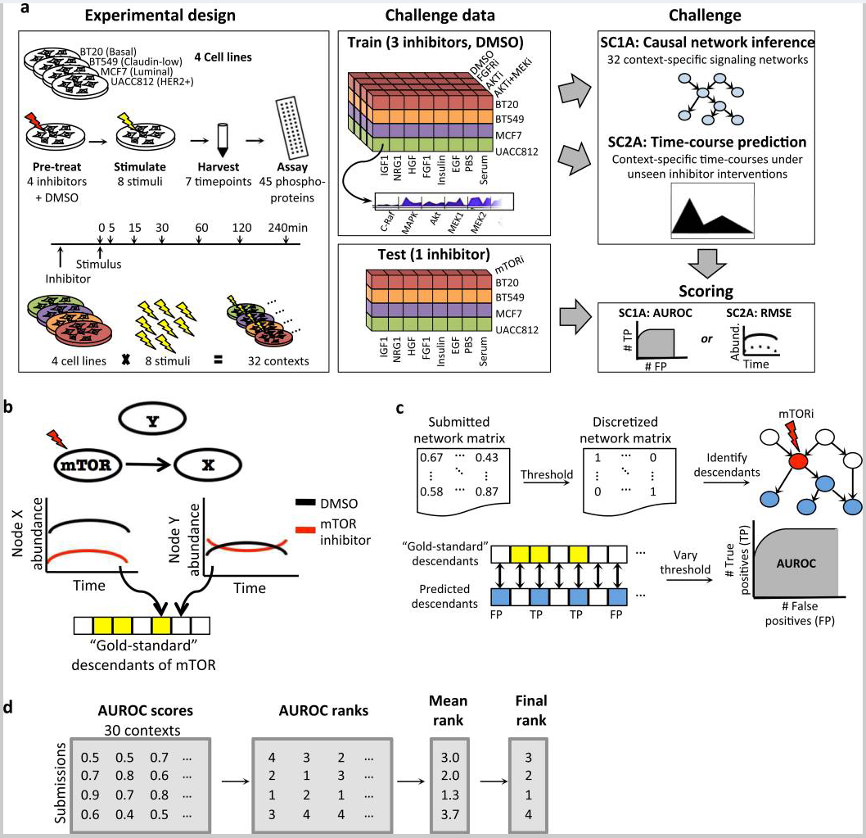
DREAM challenge: inferring causal networks
Nat Methods (2016) 13:310-8. doi: 10.1038/nmeth.3773
Notes:
The HPN-DREAM network inference challenge: overview of experimental data tasks and causal assessment strategy. (a) Protein data were obtained from four cancer cell lines under eight ligand stimuli (data as described in Hill, Nesser et al.36). For each of the 32 resulting contexts, participants were provided training data comprising time-courses for ~45 phosphoproteins under three different kinase inhibitors and a control (DMSO). The sub-challenge 1 experimental data task (SC1A) asked participants to infer signaling networks specific to each context. In SC2A the aim was to predict context-specific molecular time-courses. In both cases, submissions were assessed using held-out, context-specific test data that were obtained under an unseen intervention (inhibition of the kinase mTOR). Each sub-challenge also comprised a companion in silico data task (SC1B/SC2B; text, Online Methods and Supplementary Fig. 1). (b) Networks submitted to the experimental data task (SC1A) were assessed causally in terms of agreement with the interventional test data. For each context, the set of nodes that changed under mTOR inhibition was identified (“gold-standard” causal descendants of mTOR; see text and Online Methods). In the example shown, node X is a descendant of mTOR while Y is not. (c) In submitted, context-specific networks, predicted descendants of mTOR were identified and compared with their experimentally-determined “gold-standard” counterparts. This gave true and false positive counts and a (context-specific) AUROC (area under the receiver operating characteristic curve). (d) In each context, teams were ranked by AUROC score and mean rank across contexts gave the final rankings (Table 1).

Slide 39
